Slide 1
GROUP 12 MINIPROJECT
AI BILLER
GROUP MEMBERS
ABDUL ANZIL B - TLY19EC001
ABDUL HADI K K - TLY19EC002
AFNAD C A - TLY19EC004
FAYIZ C K - TLY19EC042
GUIDE: Asst Prof ANAS A K

Slide 2
AI Biller is an AI-powered autonomous checkout system for retail stores
Provide an amazing shopping experience.
ABSTRACT

Slide 3
AI Biller uses computer vision and machine learning to visually detect and instantly identify the items placed and the weight sensor measure the weights of the things placed on the counter-top.​
Once the items are identified, things are automatically added to the cart and the bill is generated instantaneously.​
QR code is generated and users can pay the bill by scanning the QR code
ABSTRACT

Slide 4
FEATURES
AI-powered
Instant checkout
Contact-free checkout
Easy deployment

Slide 5
WORK FLOW
Weight Sensor
Yes
Home Page
Success Page
Yes
Empty Data
Raspberry Pi
REST API
Payment
Success
No
Checkout Page
QR Code
(UPI)
Camera Module
No
HARDWARE
SOFTWARE

Slide 6
COMPONENTS USED

Slide 7
Raspberry Pi 4B
Camera Module
Weight Sensor (Load Cell)
HX711 Break outboard
Jumper wires
Touch Screen Display

Slide 8
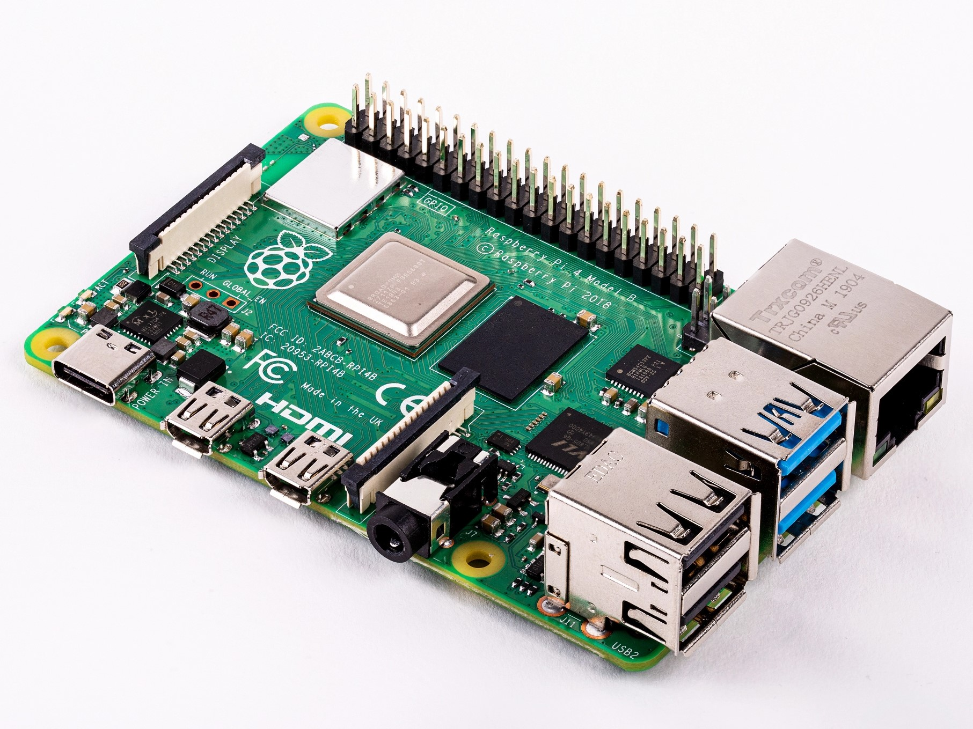
1. Raspberry Pi 4B
COMPONENTS USED

Slide 9
1. Raspberry Pi 4B
COMPONENTS USED
The brain of the device is Raspberry Pi. All major processes are carried out by this device.

Slide 10
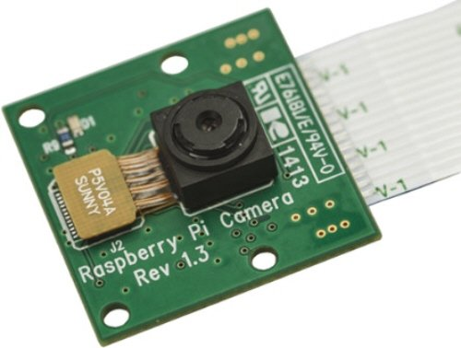
2. Camera Module
COMPONENTS USED

Slide 11
2. Camera Module
COMPONENTS USED
Raspberry Pi 5MP Camera Module for object detection.
High definition 5MP camera that has the ability to capture good quality photos.

Slide 12
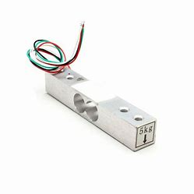
3. Weight Sensor (Load Cell)
COMPONENTS USED

Slide 13
3. Weight Sensor (Load Cell)
COMPONENTS USED
The load cell is a sensor that converts a load or force acting on it into an electric signal.
This electric signal can be a voltage change or current change depending on the type of load cell and circuitry used.
There are many different kinds of load cells.
Here we are using a resistive load cell.

Slide 14
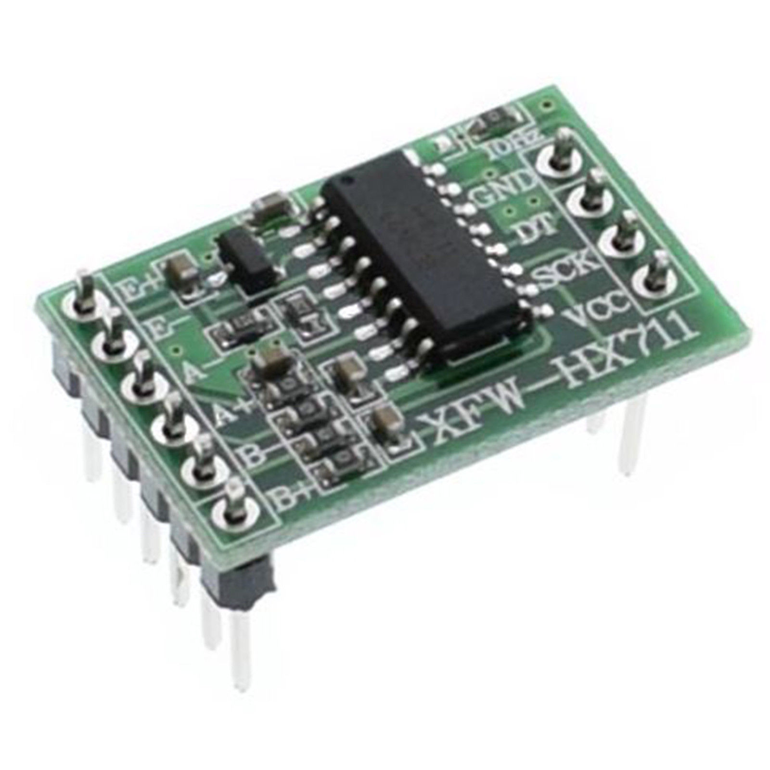
4. HX711 Break outboard
COMPONENTS USED

Slide 15
4. HX711 Breakout board
COMPONENTS USED
The HX711 module is a Load Cell Amplifier breakout board that allows us to easily read load cells to measure weight.
HX711 is an IC that allows us to easily integrate load cells into the project. No need for any amplifiers or dual power supply, just use this board and we can easily interface it to any micro-controller or micro-processor to measure weight.

Slide 16
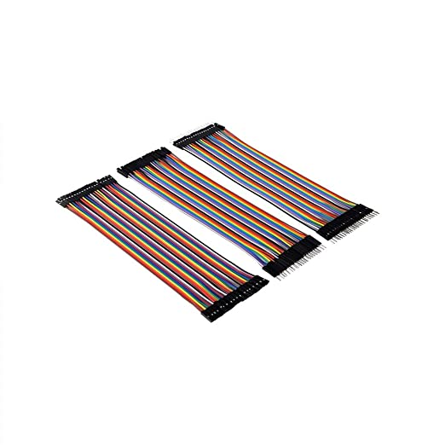
5. Jumper wires
COMPONENTS USED

Slide 17
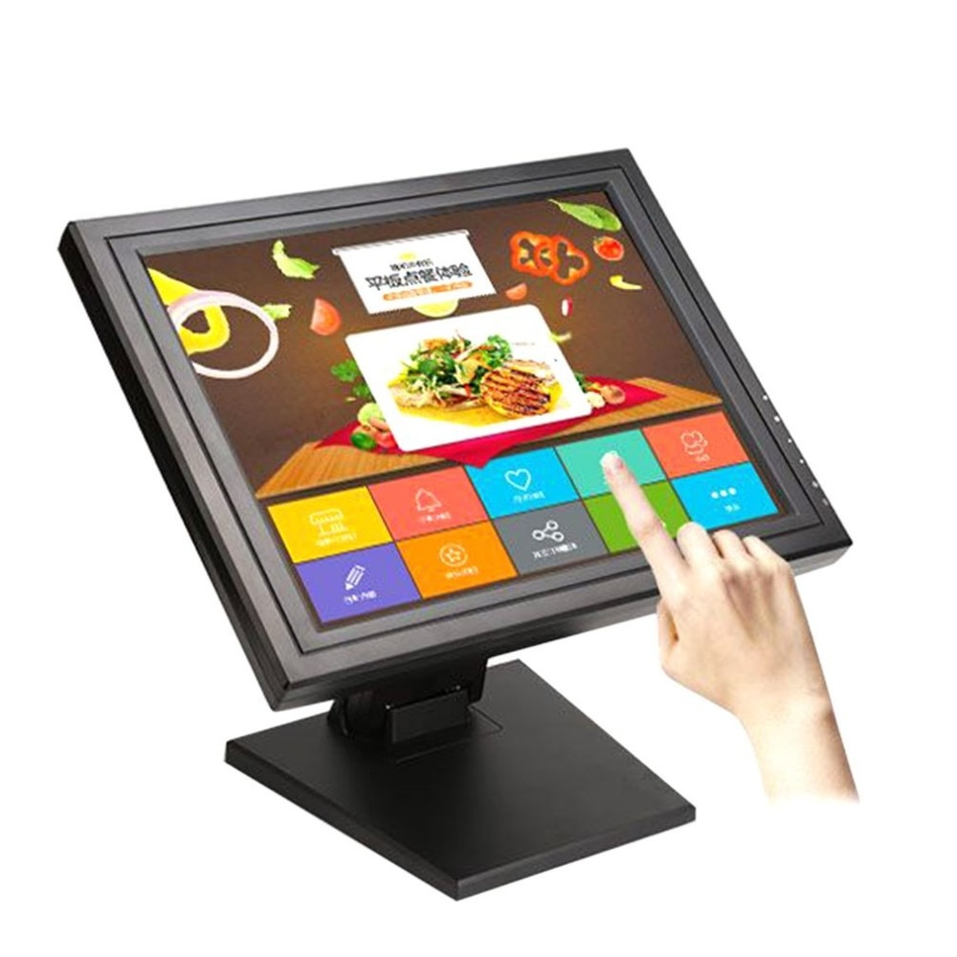
6. Touch Screen Display
COMPONENTS USED

Slide 18
SECURING COMPONENTS

Slide 19
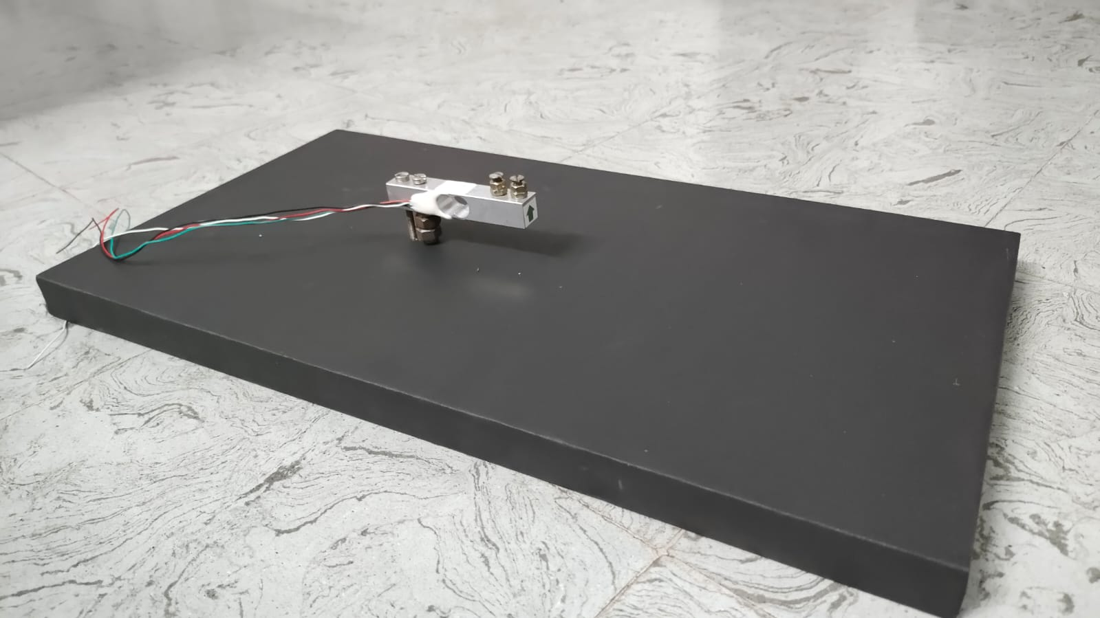
Initially, we attached the load cell on the cabinet with the help of Nuts and bolts.
One end of the load cell should be rigidly connected and another end should be floated in the air, then only we get the proper weight of the object.

Slide 20
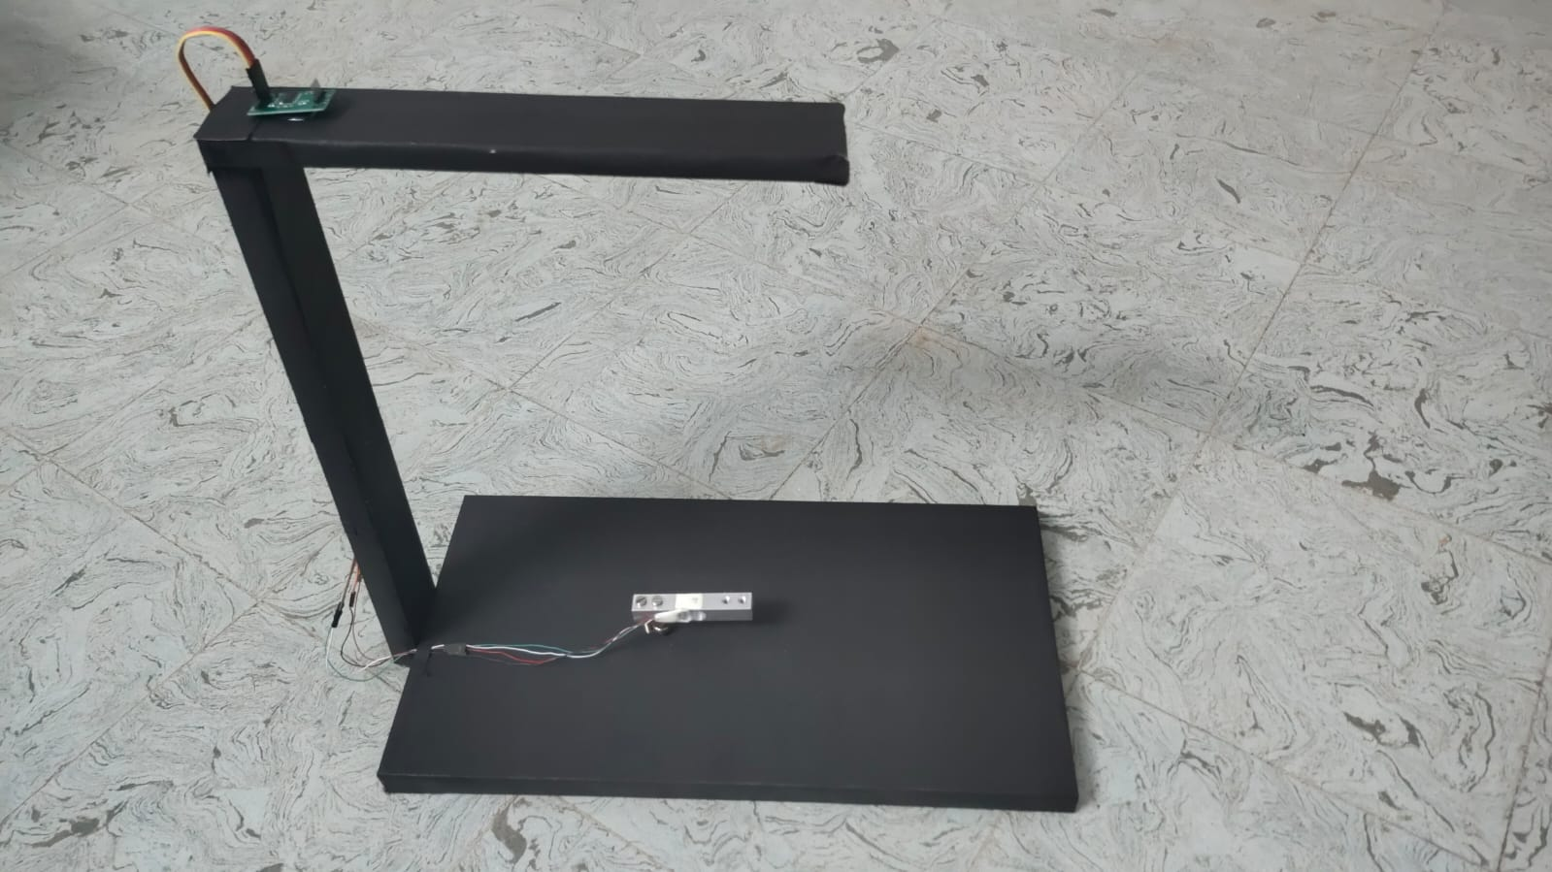
Then we wired the load cell to the HX711 break-out module by installing it.

Slide 21
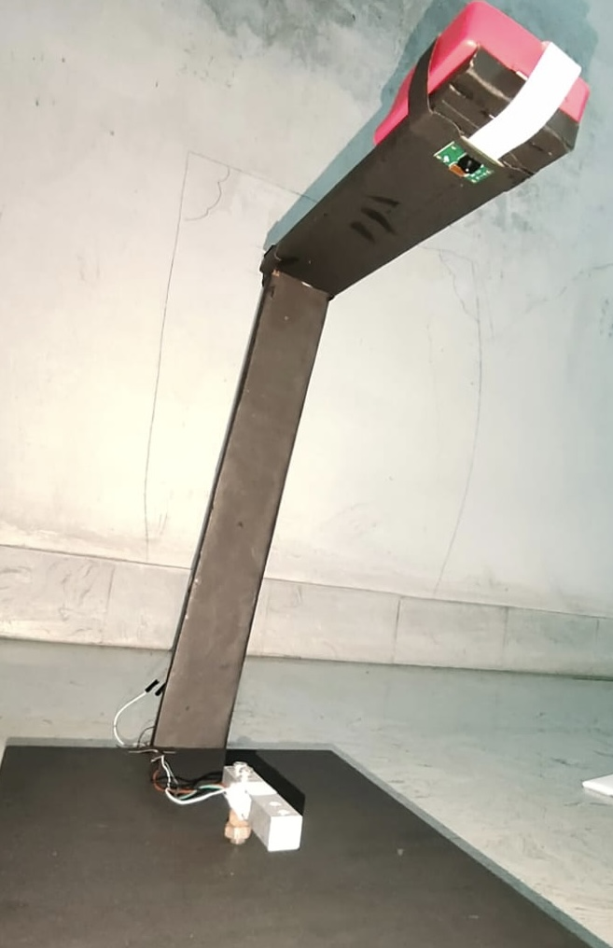
Then we installed the camera module at the opposite face of the load cell, and the flex cable from the camera module is pulled out.

Slide 22
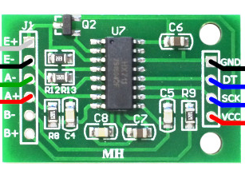
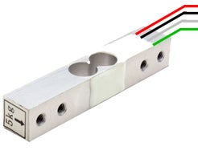
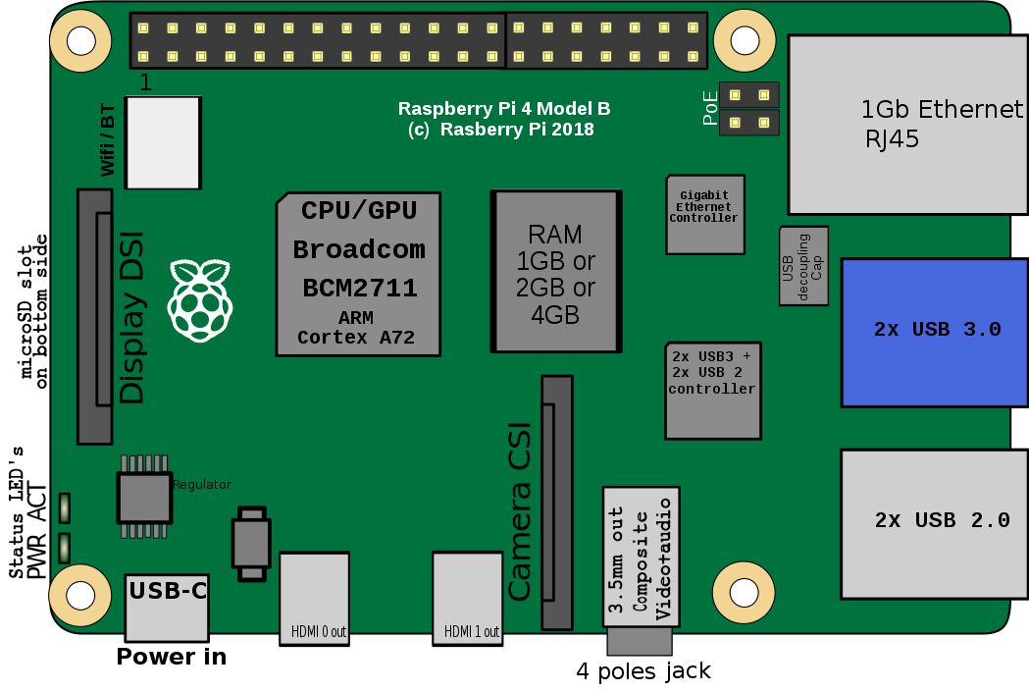
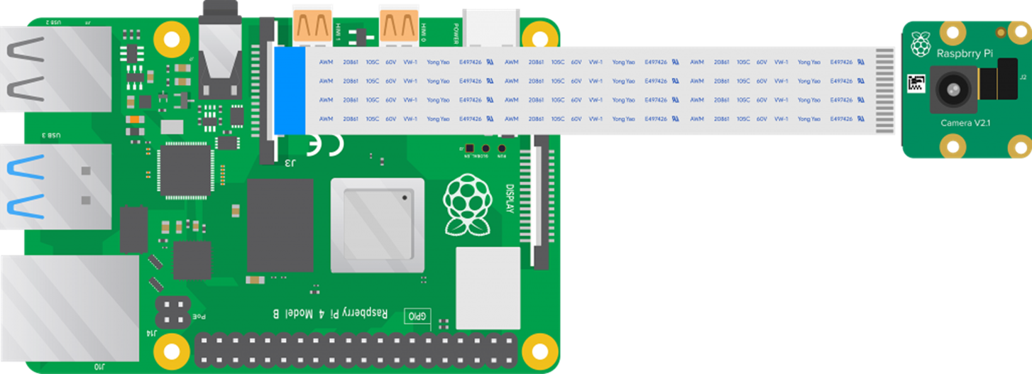

Then we attached the raspberry pi and wired the whole components as per the schematics.
HX711
2
6
29
31
LOAD CELL
RASPBERRY PI 4B
CAMERA MODULE

Slide 23
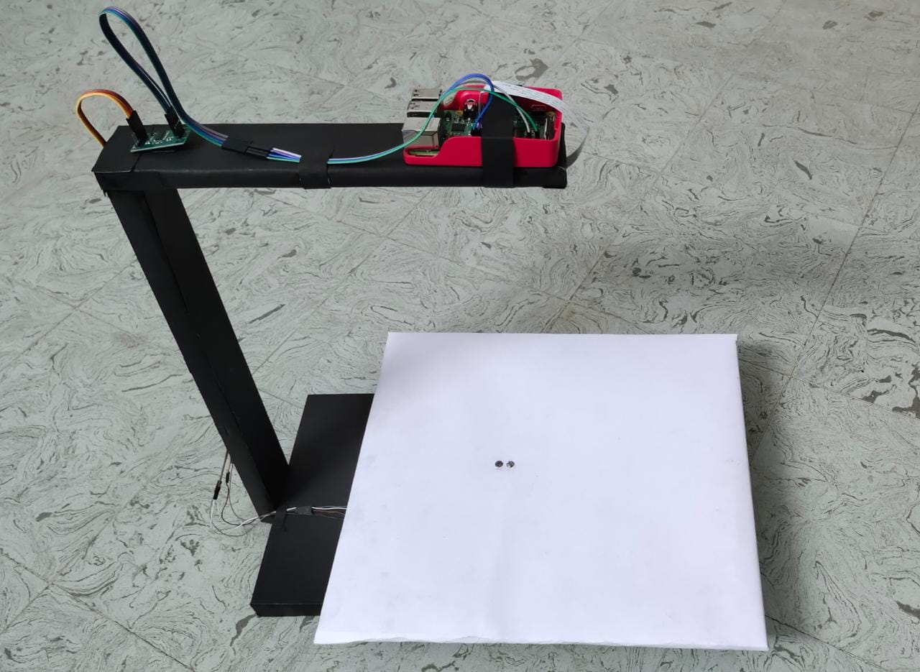
The final will look like this.

Slide 24

OBJECT DETECTION

Slide 25
Edge Impulse is one of the leading development platforms for machine learning
Here we are using machine learning to build a system that can recognize the products available in the shops.
Then we deploy the system on the Raspberry Pi 4B.
OBJECT DETECTION

Slide 26
There are three main steps to be done here :
Data acquisition
Labelling Data
Designing Impulse
After these, we deploy into Raspberry Pi.
OBJECT DETECTION

Slide 27
CODING PART

Slide 28
The entire code for the device is written in Python and the Checkout page is developed using Flask.
The checkout interface has two parts,
1. Front-end developed using HTML, CSS and JavaScript
2. Backend API developed using Flask

Slide 29
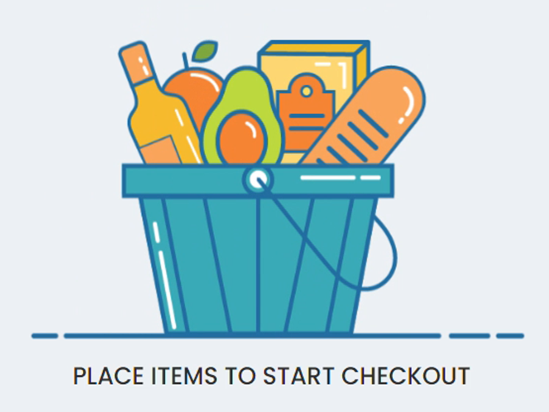
DEMONSTRATION
Display
Raspberry Pi
Camera Module
Trey
Load Cell
HX711

Slide 30

DISPLAY

Slide 31


Slide 32
DISPLAY
PRODUCT: PEARS SOAP PER UNIT: 80 UNITS: 1NOS PAYABLE: Rs.80
CHECKOUT Rs.80

Slide 33
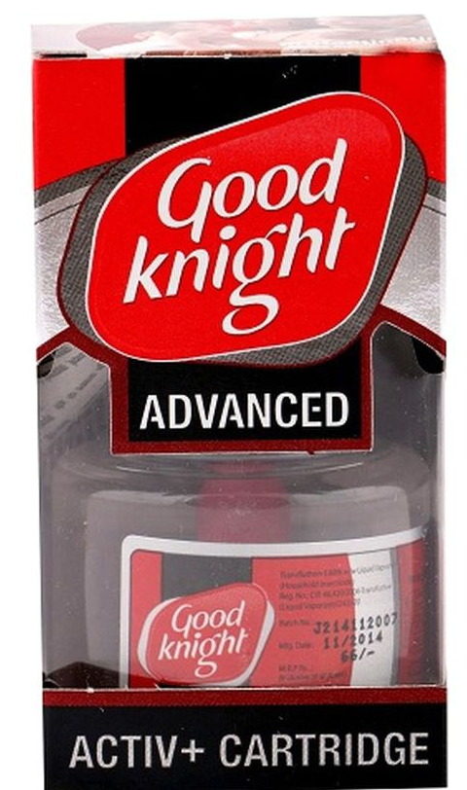

Slide 34
DISPLAY
PRODUCT: PEARS SOAP PER UNIT: 80 UNITS: 1NOS PAYABLE: Rs.80
PRODUCT: GOOD KNIGHT PER UNIT: 60 UNITS: 1NOS PAYABLE: Rs.60
CHECKOUT Rs.140

Slide 35


Slide 36
DISPLAY
PRODUCT: PEARS SOAP PER UNIT: 80 UNITS: 1NOS PAYABLE: Rs.80
PRODUCT: GOOD KNIGHT PER UNIT: 60 UNITS: 1NOS PAYABLE: Rs.60
PRODUCT: APPLE PER UNIT: 90 UNITS: 0.5KG PAYABLE: Rs.45
CHECKOUT Rs.185

Slide 37

After the CHECKOUT button is clicked, a QR code will be displayed.
We can pay via any UPI app by scanning that QR code.

Slide 38
What's in the Future?
Generate Digital Receipt
Keeps Transaction History
Screen Promotions and Offers
Integration for multiple stores for easy analytics

Slide 39
THANKYOU

